Slide 1
Parallel and distributed
databases
Tilak Poudel
Roll no.39

Slide 2
What Are We Covering?
Key differences between Parallel and Distributed Databases.
How data is partitioned (sharded) and replicated.
How queries are processed across multiple nodes.
The significance of the CAP Theorem.
Practical examples and real-world technologies.

Slide 3
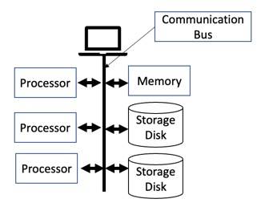
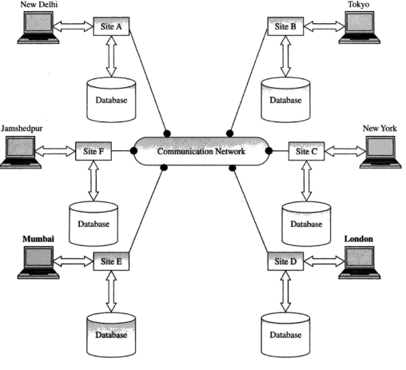
Parallel vs Distributed Databases
Parallel Databases
Involve multiple processors/disks within a single system.
Aim to speed up operations by executing tasks in parallel.
Common in data warehousing (e.g., Amazon Redshift).
Distributed Databases
Data is stored on multiple systems connected by a network.
Each system has its own memory and processor.
Focus on scalability, availability, and fault tolerance.

Slide 4
Why It Matters?
Understanding these systems helps to:
Handle large-scale data efficiently.
Build resilient, high-performance applications.
Choose the right database architecture for your needs.
Think like companies such as Google, Facebook, or Amazon.

Slide 5
Data Partitioning (Sharding)
Sharding is a database optimization technique where a large database is divided into smaller, more manageable pieces called "shards".
Why Partition Data?
To improve performance and manageability by splitting the data across nodes.
Types of Partitioning:
Horizontal: Distributes rows across tables. E.g., users A–M on Node1, N–Z on Node2.
Vertical: Distributes columns. E.g., basic user info in one table, preferences in another.
Hash-based: Uses a hash function to spread data evenly (e.g., user_id % 4).

Slide 6
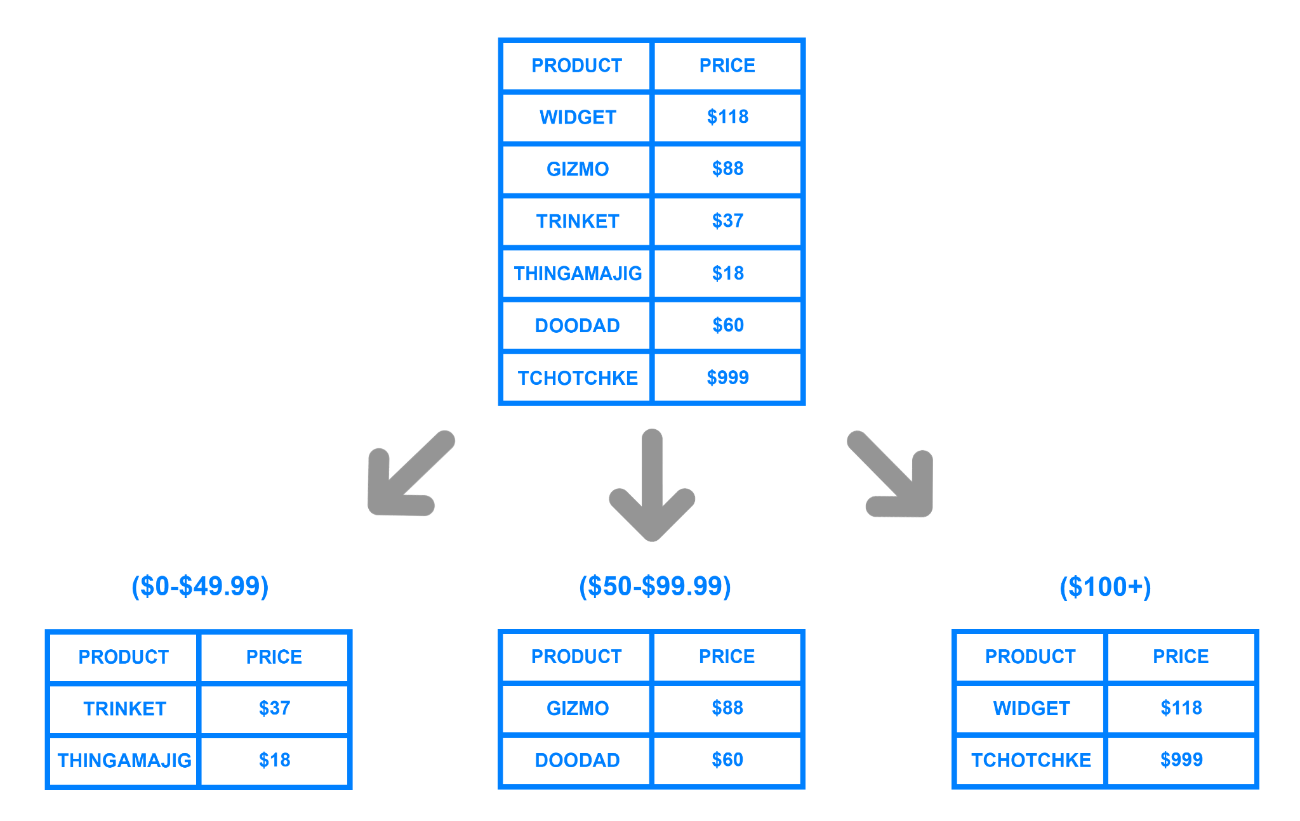
Data Partitioning (Sharding)

Slide 7
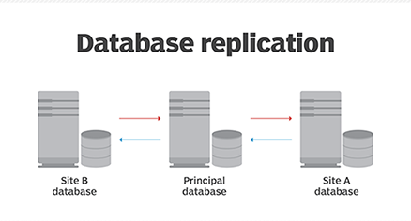
Data Replication
Why Replicate Data?
To ensure data availability, fault tolerance, and faster access.
Replication Strategies:
Synchronous: All replicas are updated together (more consistent but slower).
Asynchronous: Replicas are updated later (faster but may show stale data).
Trade-Off:
More replicas improve resilience, but also increase write complexity and latency.

Slide 8
Distributed Query Processing
How It Works:
A query is broken into parts, each executed on different nodes.
Results are then aggregated and returned to the user.
Techniques Involved:
Shipping queries (send logic to data) vs shipping data (send data to logic).
Distributed joins: Combining data across nodes.
Semi-joins: Reduce data transfer by pre-filtering.
Data locality: Perform computation where the data resides.

Slide 9
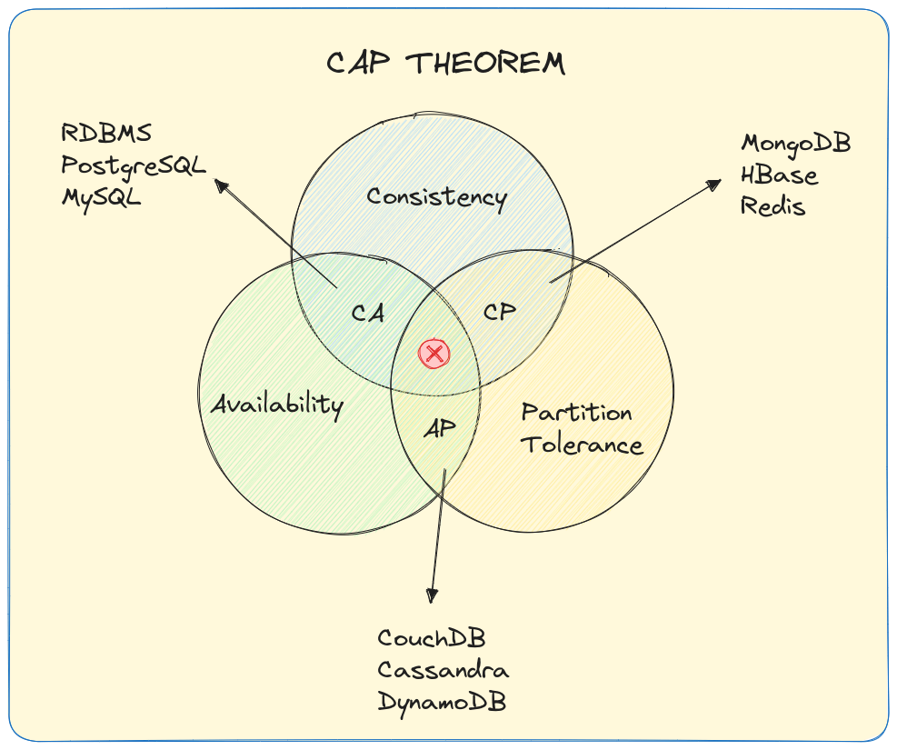
CAP Theorem
The CAP Theorem (by Eric Brewer) says a distributed system can only guarantee 2 of the following 3 at the same time:
Consistency – Every read gets the latest write.
Availability – Every request gets a response (even if stale).
Partition Tolerance – The system continues to operate even if some messages are lost/delayed between nodes.
Trade-off Examples:
Google Spanner = CP (Consistency + Partition Tolerance)
Cassandra = AP (Availability + Partition Tolerance)
MongoDB = Tunable (you can adjust behavior)

Slide 10
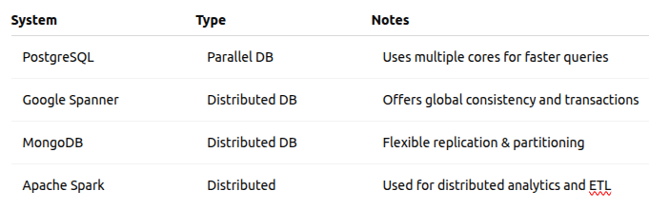
Real-World Technologies

Slide 11
Final Takeaways
Parallel DBs are for speed on a single system;
Distributed DBs are for scale across systems.
Partitioning and Replication are the backbone of both types.
Distributed query processing and CAP trade-offs explain real-world DB behavior.

